Slide 1

TATA - Data Visualisation: Empowering Business with Effective Insights
The Forage
Welcome to my deep dive into retail sales of 2011, leveraging data to uncover key trends and opportunities. This presentation highlights critical insights derived from my recent analysis, designed to inform strategic decisions for the CEO and CMO.
By, Sai Darshan Balaji

Slide 2




Transforming Data into Actionable Insights
My virtual internship journey of TATA at The Forage focused on real-world retail data, enabling me to answer critical business questions and create compelling, interactive visualizations. This project enhances my ability to analyze data, tell a compelling story, and build powerful dashboard.
Data Cleaning
Exploratory Analysis
Ensuring accuracy and consistency for reliable analysis.
Framing key business questions from a strategic perspective.
Data Visualization
Presentation
Creating intuitive and interactive dashboards to reveal insights.
Delivering clear, concise insights to stakeholders for informed decisions.

Slide 3

Ensuring Data Accuracy: Cleaning Process
Before any analysis, as part of the task I meticulously cleaned the raw sales data to guarantee the reliability of the insights. This foundational step eliminates inconsistencies and errors, providing a trustworthy basis for strategic decisions.
Removed all transactions with negative quantities, indicating returns or incorrect entries, to focus solely on valid sales.
Filtered out entries where unit prices were zero or negative, ensuring all products contributed positively to revenue figures.
Specifically focused on transactions from the year 2011 to analyze the most recent and relevant sales trends.
Standardized column formats across the dataset to ensure seamless integration and analysis.

Slide 4
Unlocking Insights: Addressed Key Business Questions
The analysis was driven by specific questions from the CEO and CMO, designed to provide actionable intelligence for strategic planning and growth initiatives. I sought to understand trends, identify opportunities, and pinpoint top performers.
1
Monthly Revenue Trends for 2011
2
Top 10 International Countries by Revenue
To identify seasonal revenue patterns and support demand forecasting, helping me optimize inventory and marketing efforts throughout the year.
To highlight high-performing international markets (excluding the UK) for focused marketing campaigns and potential expansion strategies.
3
Top 10 Customers by Revenue
4
Product Demand by Country
To identify high-value customers, enabling me to develop targeted retention strategies and loyalty programs.
To determine high-demand regions globally and evaluate the most promising expansion opportunities for future growth.

Slide 5
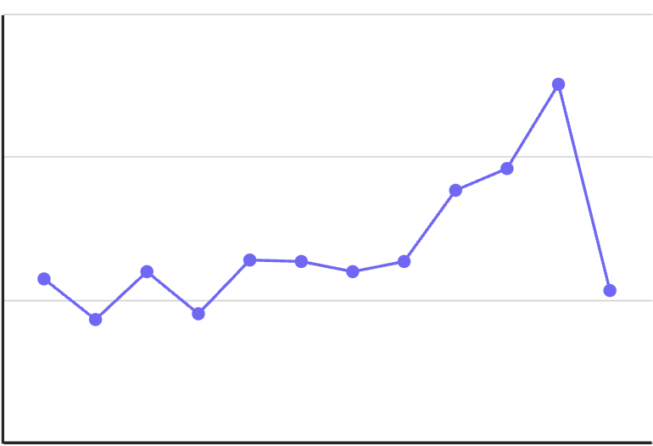
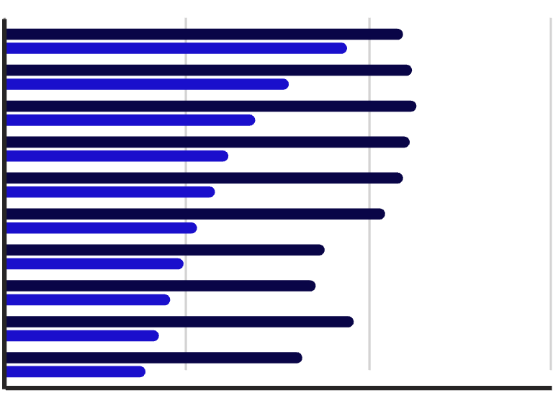
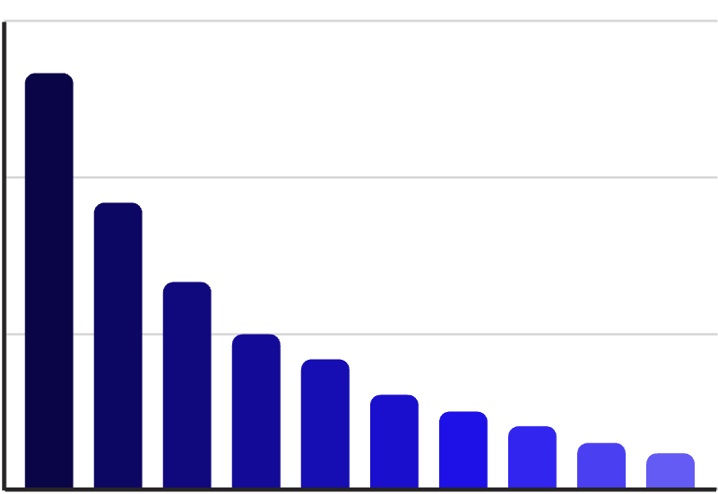
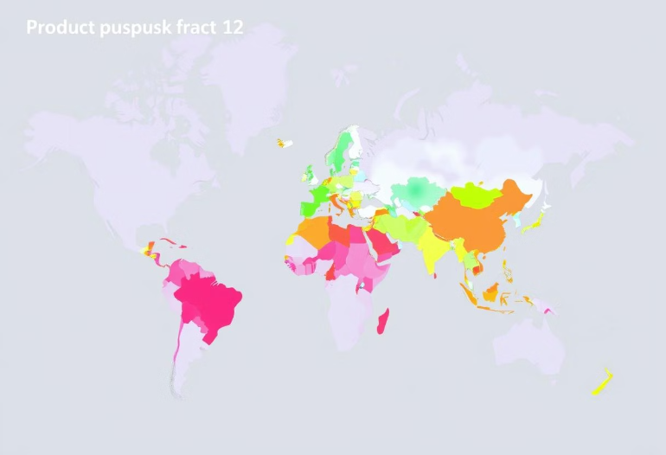
Visualizing the Findings: Key Dashboard
The analysis culminated in interactive dashboards that transform complex data into clear, digestible visual insights, making it easier for stakeholders to grasp key information at a glance.
Charts / Visualizations used:
Line Chart
Side by Side Chart
Bar Chart
Map

Slide 6
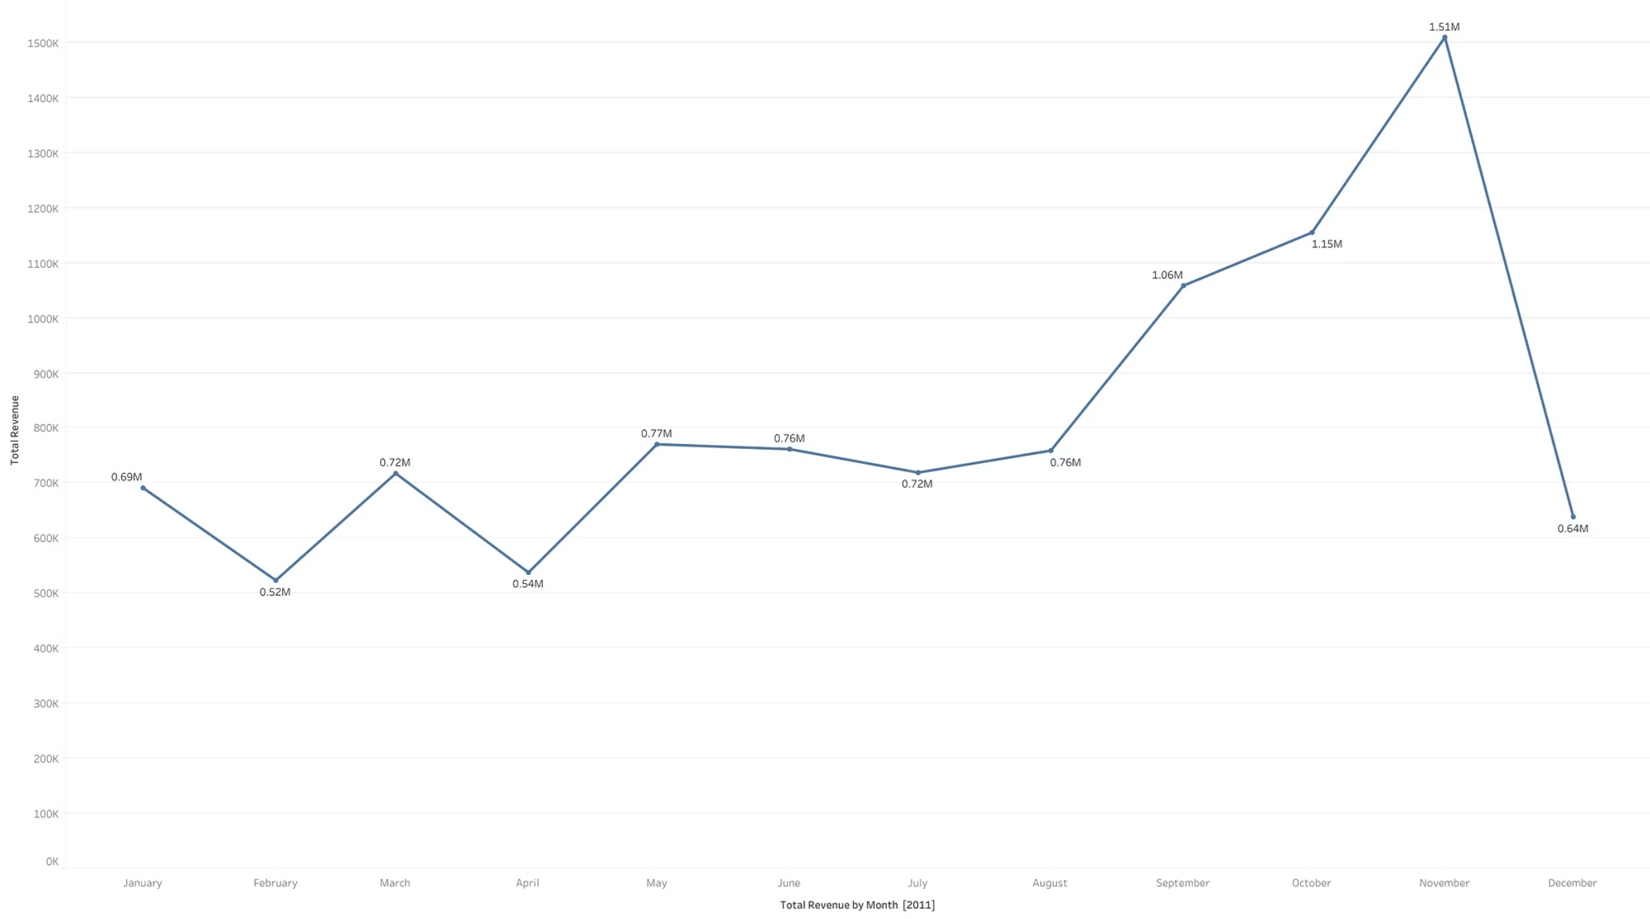
2011 Revenue Trends: Unpacking Seasonality and Peaks
Analyzing monthly revenue trends for 2011 reveals clear seasonal patterns, crucial for forecasting and resource allocation. Understanding these cycles allows me to anticipate demand and strategize effectively.
Q1. The CEO of the retail store is interested to view the time series of the revenue data for the year 2011 only. He would like to view granular data by looking into revenue for each month. The CEO is interested in viewing the seasonal trends and wants to dig deeper into why these trends occur. This analysis will be helpful for the CEO to forecast for the next year.
The line chart clearly indicates a significant revenue peak in November, coinciding with holiday shopping seasons. This suggests opportunities for intensified marketing efforts and inventory stocking during this period. Revenue generally grew throughout the year, with a slight dip in February and July before a strong rebound.

Slide 7
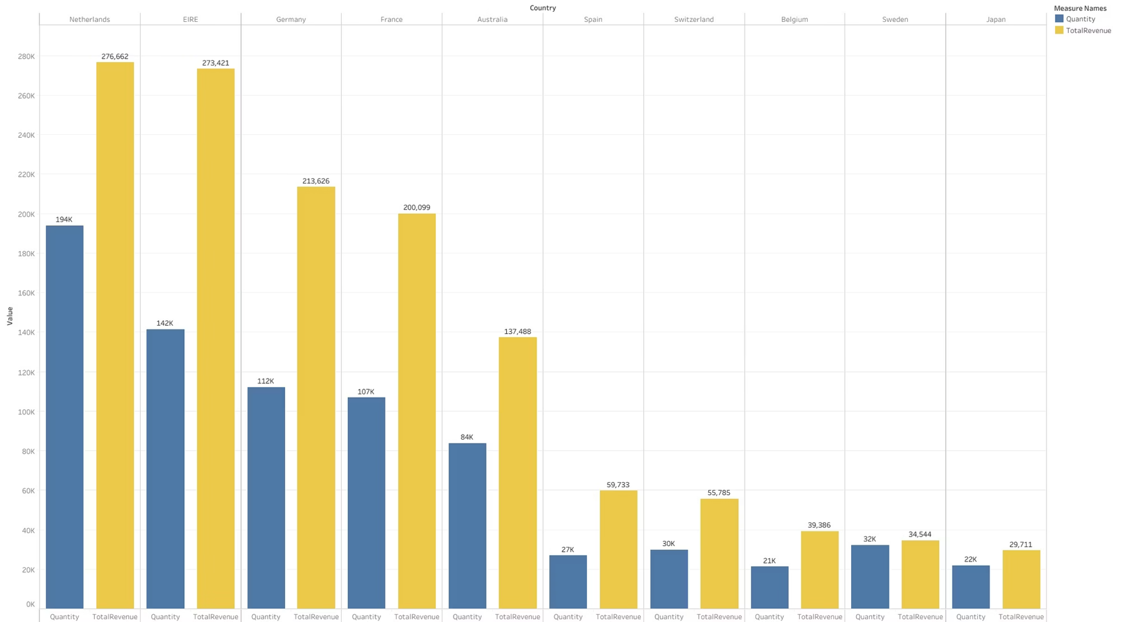
Global Footprint: Top International Markets
Identifying the highest-performing international markets (excluding the UK) is crucial for targeted expansion and marketing. These countries represent the most immediate opportunities for growth and investment.
Q2. The CMO is interested in viewing the top 10 countries which are generating the highest revenue. Additionally, the CMO is also interested in viewing the quantity sold along with the revenue generated. The CMO does not want to have the United Kingdom in this visual.
The Netherlands, Ireland, and Germany stand out as our top international markets, demonstrating strong revenue contributions. These countries should be prioritized for enhanced marketing efforts and strategic resource allocation to maximize their potential.

Slide 8
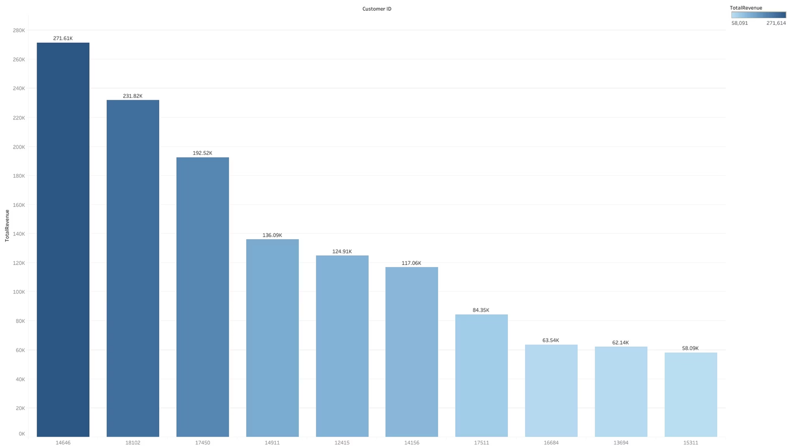
Valuable Relationships: Identifying Our Top Customers
Understanding who the top customers are by revenue is vital for developing effective retention strategies. Nurturing these high-value relationships can significantly impact long-term growth and profitability.
Q3. The CMO of the online retail store wants to view the information on the top 10 customers by revenue. He is interested in a visual that shows the greatest revenue generating customer at the start and gradually declines to the lower revenue generating customers. The CMO wants to target the higher revenue generating customers and ensure that they remain satisfied with their products.
The bar chart reveals the customer IDs generating the most revenue. Customer ID 14646 leads the list, followed closely by 18102 and 17450. Focusing on these high-value customers through loyalty programs, personalized offers, and exceptional service will be key to boosting retention and lifetime value.

Slide 9
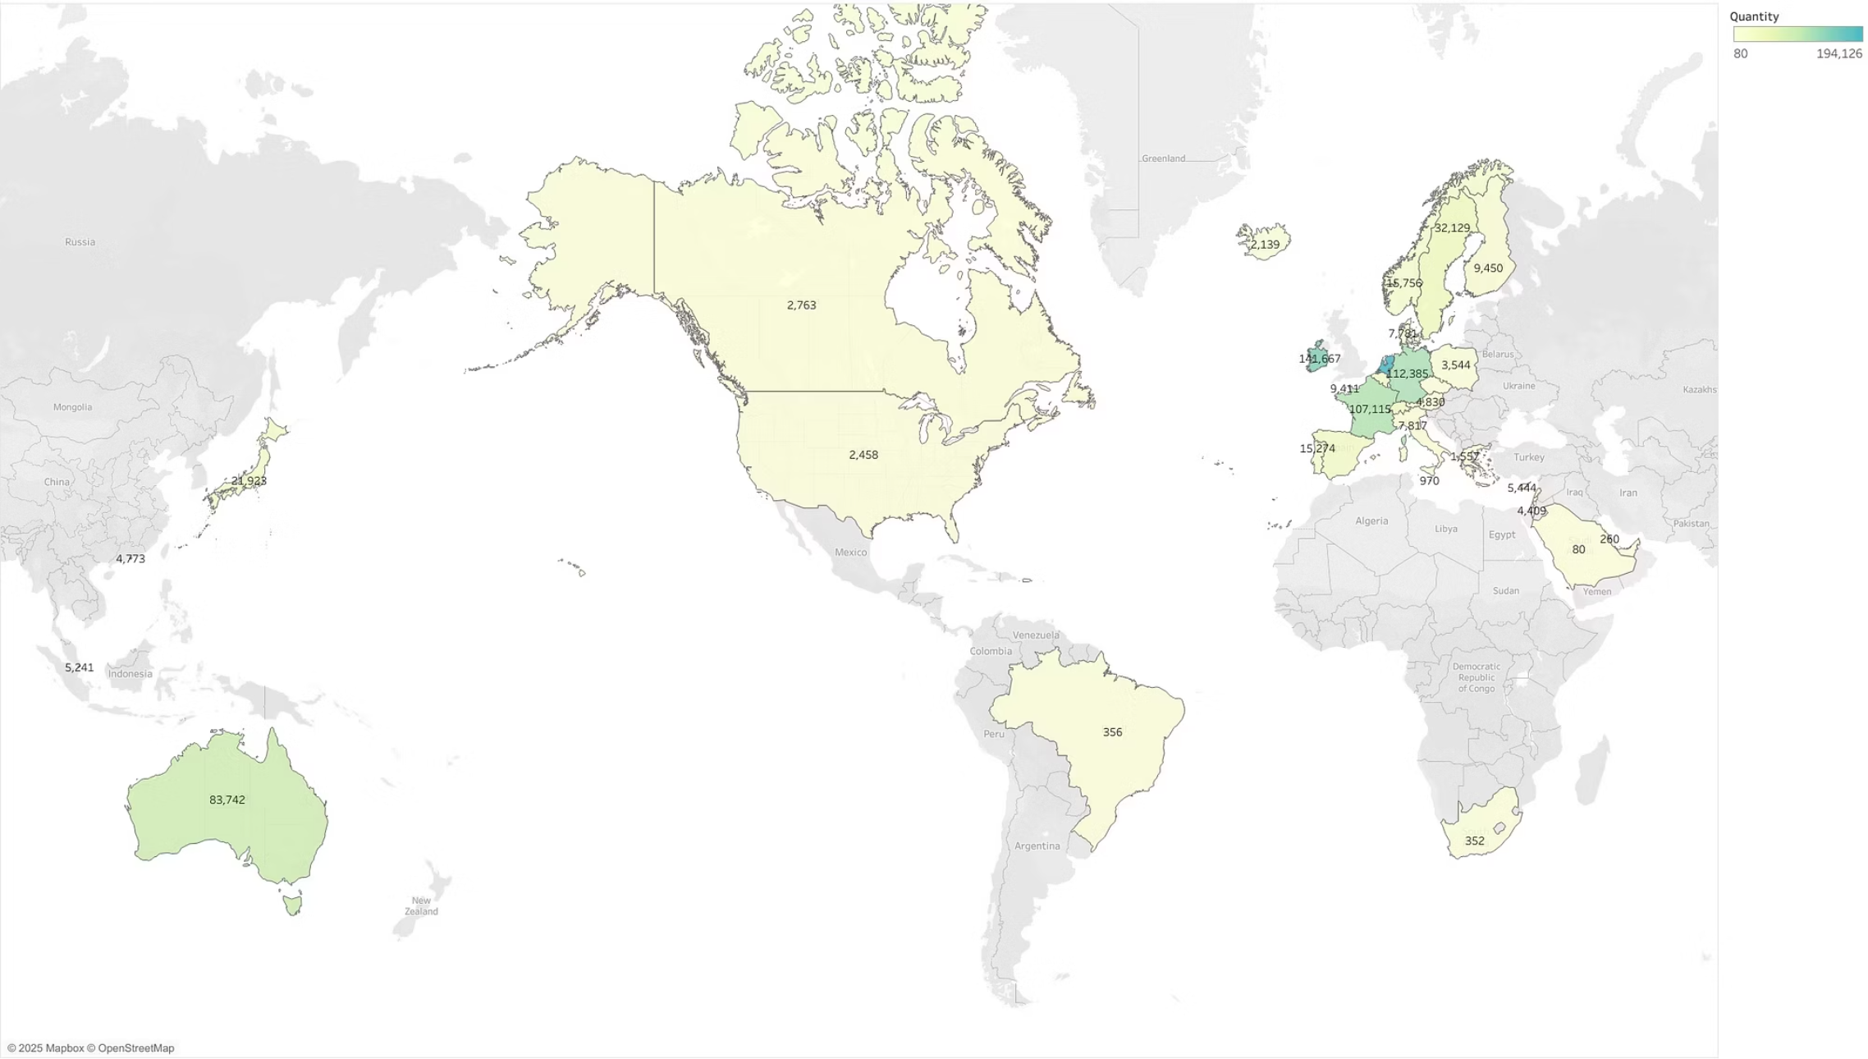
Future Growth: Identifying Expansion Opportunities
Beyond current performance, I analyzed product demand by country to pinpoint where the products resonate most. This helps me evaluate potential new markets for expansion and strategic investment.
Q4. The CEO is looking to gain insights on the demand for their products. He wants to look at all countries and see which regions have the greatest demand for their products. Once the CEO gets an idea of the regions that have high demand, he will initiate an expansion strategy which will allow the company to target these areas and generate more business from these regions. He wants to view the entire data on a single view without the need to scroll or hover over the data points to identify the demand. There is no need to show data for the United Kingdom as the CEO is more interested in viewing the countries that have expansion opportunities.
The product demand map clearly illustrates areas of high interest for our products, particularly in Western Europe and parts of Australia. These regions show significant demand, making them prime candidates for future expansion strategies, including localized marketing campaigns and distribution network development.

Slide 10




Key Takeaways & Next Steps
This analysis provides a clear roadmap for enhancing retail sales and driving growth. By focusing on seasonality, key international markets, and high-value customers, you can optimize our strategies for maximum impact.
Optimize for Seasonality
Expand Internationally
Capitalize on peak months like November with targeted campaigns and inventory.
Focus marketing and resources on high-potential markets like the Netherlands and Ireland.
Retain Top Customers
Explore New Markets
Implement strategies to nurture and reward our most valuable customers.
Investigate high-demand regions for future strategic expansion.
Thank you.

